Slide 1
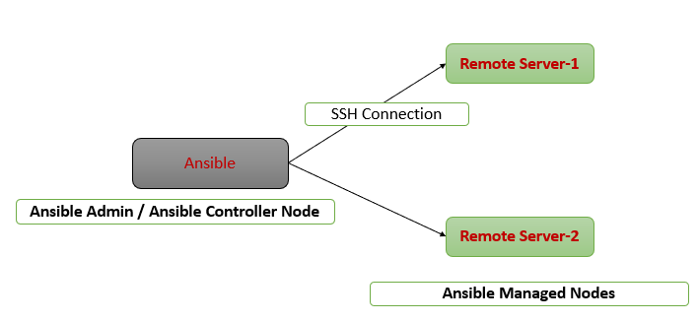
Ansible Configuration
Before Continuing with this video make sure that:
You have Ansible Controller Node with ansible-core installed
Preferer to use WSL2 CentOS as Ansible Controller Node
Two Nodes from Any of Your Favorite Cloud
One is from RHEL Family - RHEL Linux, – Amazon Linux, Oracle Linux
Other One is from Debian Family – Ubuntu, Kali Linux, Mint Linux
Ansible and Ansible-Playbooks For Automation

Slide 2
Configuring Ansible for Your Project
There are different ways to configure Ansible in real-time
Let me go with the setup if you decided to use Ansible for your project
Step1: Create ansadmin user across all servers
Imp Point: Not only ansadmin user , any unique user across all servers like automation, devops, ansadmin, cloudadmin etc…
Step2: Provide the root access for this ansadmin user on all servers
Step3: Generate SSH Keys on Ansible Controller node from ansadmin user and exchange them with managed nodes with the same ansadmin user
Step4: Login into ansible controller node and switch to ansadmin user
Step5: Create a directory for your project, let say /home/ansadmin/myproject
Step6: Verify connectivity from your ansible controller node to ansible managed nodes using
ansible all -m ping
ansible all -m ansible.builtin.ping
Ansible and Ansible-Playbooks For Automation

Slide 3
Important Points to Remember
Under your project directory:
Create inventory file with any name – it should have the IP’s/FQDN’s of managed nodes
Create ansible.cfg
Note: we will also see,
How to use ansible without keys – using username and password
how to use ansible even without ansadmin user
Ansible and Ansible-Playbooks For Automation

